Slide 1
Estimating the gender differences in technology adoption in the presence of (nonclassical) measurement error
Presenter: Jing Yi
This material is prepared for the presentation on April 19, 2023

Slide 2
Introduction & Motivation
The importance of incorporating a gender perspective in social and economic sectors
Literature (World Bank, FAO, Quisumbing et al. (2014), Fortmann (2009)) has emphasized that neglecting to acknowledge the varying roles, disparities, and inequalities between men and women in the agricultural sector poses a significant risk to the success of agricultural development efforts
Adoption/yield/income/technology = f (assets, gender, education, age, etc.)
Notes:
Gender in agriculture
Fortmann, Louise. "Gender in Agriculture Sourcebook. The World Bank, Food and Agricultural Organization, and International Fund for Agricultural Development. Washington DC: The World Bank (2009), pp. 727+ 36pp. index, US $34.95. ISBN 978-0-8213-7587-7." Experimental Agriculture 45, no. 4 (2009): 515-515.

Slide 3
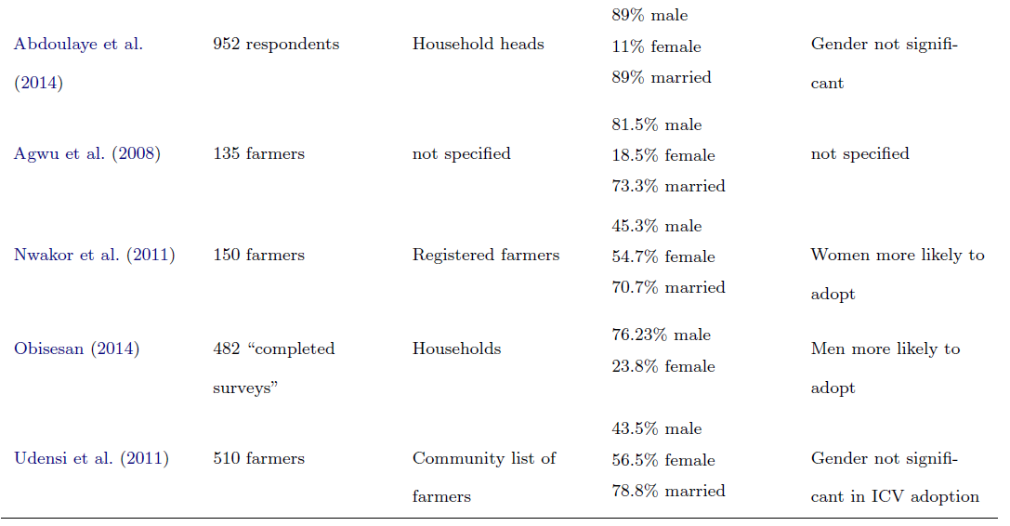

Slide 4
Introduction & Motivation (count.)
self-reported data is possibly misclassified
Survey data on participation in social programs is subject to significant misreporting, with levels of misreporting that can reach as high as 50% (Meyer et al., 2009)
Meyer, Bruce D., Nikolas Mittag, and Robert M. Goerge. "Errors in survey reporting and imputation and their effects on estimates of food stamp program participation." Journal of Human Resources 57, no. 5 (2022): 1605-1644.
Wossen et al. (2019) indicated that the misreporting of adoption status is not exogenous to the household’s characteristics.
Lynch et al. (2007) and Meyer et al. (2018) report that validation studies always find high rates of false negatives in the Supplemental Nutrition Assistance Program (SNAP) ranging from 20% to 50%, depending on the survey and period after reviewing 35 case studies
- Meyer, Bruce D., and Derek Wu. "The poverty reduction of social security and means-tested transfers." ILR Review 71, no. 5 (2018): 1106-1153.
Notes:
Over the last twenty years, there has been a growing body o
Ragasa (2012) found that women have ”much slower observed rates of adoption of a wide range of technologies than men.”
f research that specifically addresses the issue of measurement error.

Slide 5
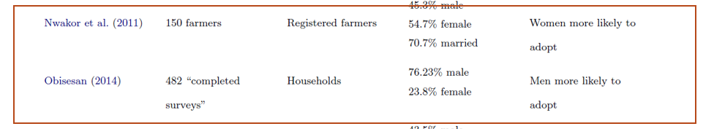
Introduction & Motivation (count.)
Gender difference in adoption or difference in reporting
Ragasa (2012) found that women have ”much slower observed rates of adoption of a wide range of technologies than men.
Ragasa, Catherine. "Gender and institutional dimensions of agricultural technology adoption: a review of literature and synthesis of 35 case studies." (2012).
Adoption/yield/income/technology = f (assets, gender, education, age, etc.)

Slide 6
Overview of the paper
The impact of measurement error on parameter estimates
Evidence on measurement error in Cassava survey
Correcting for measurement error

Slide 7
The impact of measurement error on parameter estimates
Gundersen, C. and Kreider, B., 2008. Food stamps and food insecurity what can be learned in the presence of nonclassical measurement error?. Journal of Human Resources, 43(2), pp.352-382

Slide 8
Evidence on measurement error in Cassava survey
Compared reported income in the 1977 wave of the Current Population Survey to the social security match fiel for respondents who provided a valid social security number. They ofund that measurement error is correlated with the true valuable, especially in te tails of the distribution. [Bound, John, and Alan B. Krueger. "The extent of measurement error in longitudinal earnings data: Do two wrongs make a right?." Journal of labor economics 9, no. 1 (1991): 1-24.]
At the same time, for want of alternative measures, econometric analyses of the labor supply decisions of older men and women have generally used respondents' self-assessment of their health. However, Myers ( 1982) has gone so far as to argue that there is no useful information in self-evaluated health. Men out of the labor force may mention health limitations to rationalize their behavior

Slide 9
Data
A subset of data compiled through the Cassava Monitoring Survey in Nigeria conducted,
Reviewed for ethics regarding human subject participation (IRB) and published by the International Institute of Tropical Agriculture (IITA) (Wossen et al., 2017).
The 16 states that contributed at least 80% of the total production of cassava comprise the enumeration areas (EA) across four regions (Southwest, Southeast, South-South, and North) were obtained from the National Population Commission of Nigeria.
758 households → 729 HH

Slide 10
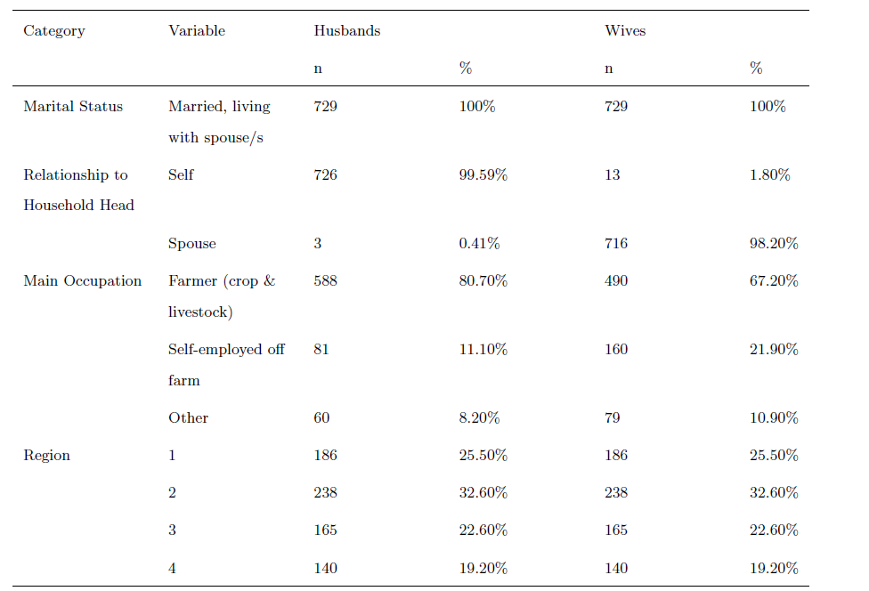
Data (count.)

Slide 11
Evidence on measurement error in Cassava survey: Adoption Rate
 | Male | Female | p-value
Adoption rate | 0.64 | 0.56 | 0.002
Female% | Adoption Rate
0% | 64%
10% | 62%
20% | 62%
30% | 60%
40% | 59%
50% | 59%
60% | 58%
70% | 58%
80% | 57%
90% | 57%
100% | 56%
Female reported are statistically significantly different from what male reported.
Pearson correlation coefficient: -0.97
Two-tailed p-value: 1.15e-06
Notes:
Difference is 14%
The table was created by the python code

Slide 12
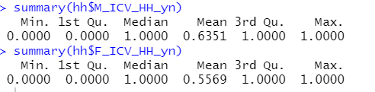
Paired t-test
pair_test_yn <- t.test(hh$M_ICV_HH_yn, hh$F_ICV_HH_yn, paired =TRUE)
Null hypothesis: The mean of the paired differences equals zero in the population.
Alternative hypothesis: The mean of the paired differences does not equal zero in the population.
Notes:
https://statisticsbyjim.com/hypothesis-testing/paired-t-test/

Slide 13
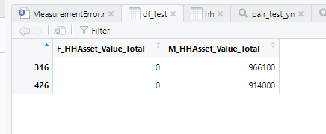
Data Summary
Two zero hh asset values

Slide 14
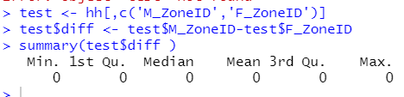
Use Region ID to test

Slide 15
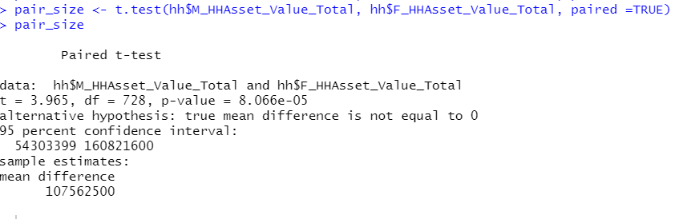
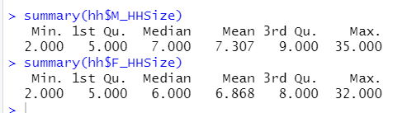
Household size is different

Slide 16
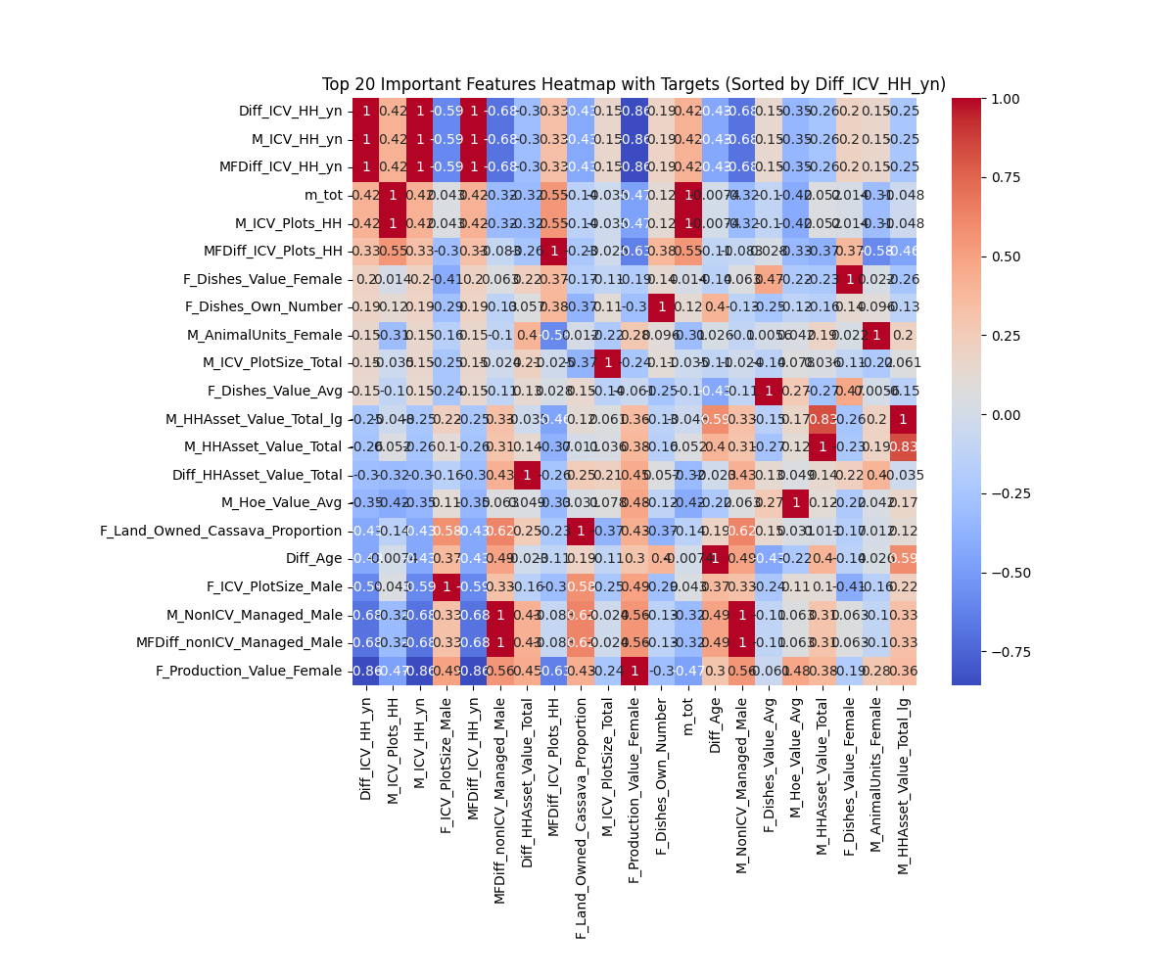

Slide 17
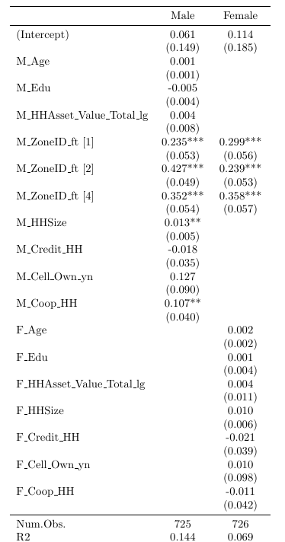

Slide 18
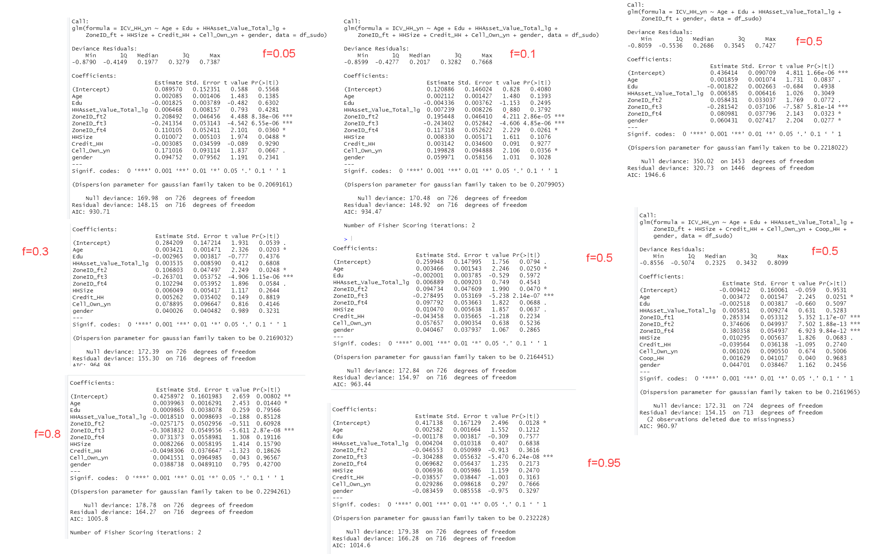

Slide 19
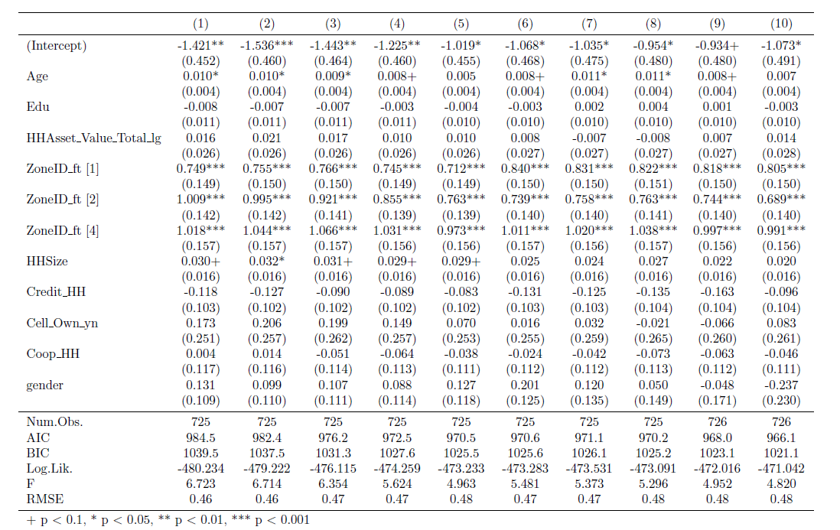

Slide 20
Female% p-value | 0% | 10% | 20% | 30% | 40% | 50% | 60% | 70% | 80% | 90% | 100%
0% | 1.000 | 0.588 | 0.516 | 0.236 | 0.096 | 0.068 | 0.047 | 0.036 | 0.014 | 0.014 | 0.002
10% | 0.588 | 1.000 | 0.914 | 0.519 | 0.260 | 0.199 | 0.149 | 0.121 | 0.055 | 0.055 | 0.012
20% | 0.516 | 0.914 | 1.000 | 0.591 | 0.309 | 0.239 | 0.181 | 0.149 | 0.070 | 0.070 | 0.017
30% | 0.236 | 0.519 | 0.591 | 1.000 | 0.631 | 0.522 | 0.424 | 0.365 | 0.202 | 0.202 | 0.063
40% | 0.096 | 0.260 | 0.309 | 0.631 | 1.000 | 0.873 | 0.750 | 0.671 | 0.426 | 0.426 | 0.169
50% | 0.068 | 0.199 | 0.239 | 0.522 | 0.873 | 1.000 | 0.873 | 0.791 | 0.525 | 0.525 | 0.224
60% | 0.047 | 0.149 | 0.181 | 0.424 | 0.750 | 0.873 | 1.000 | 0.915 | 0.633 | 0.633 | 0.290
70% | 0.036 | 0.121 | 0.149 | 0.365 | 0.671 | 0.791 | 0.915 | 1.000 | 0.711 | 0.711 | 0.341
80% | 0.014 | 0.055 | 0.070 | 0.202 | 0.426 | 0.525 | 0.633 | 0.711 | 1.000 | 1.000 | 0.562
90% | 0.014 | 0.055 | 0.070 | 0.202 | 0.426 | 0.525 | 0.633 | 0.711 | 1.000 | 1.000 | 0.562
100% | 0.002 | 0.012 | 0.017 | 0.063 | 0.169 | 0.224 | 0.290 | 0.341 | 0.562 | 0.562 | 1.000
Note: the p-value is in purple (red) if it’s ≤ 0.05 (0.01);

Slide 21
 | estimate | statistic | p.value | parameter
Total number of ICV | 0.122085 | 1.827632 | 0.068013971 | 728
Y/N ICV | 0.078189 | 4.17049 | 3.41E-05 | 728

Slide 22
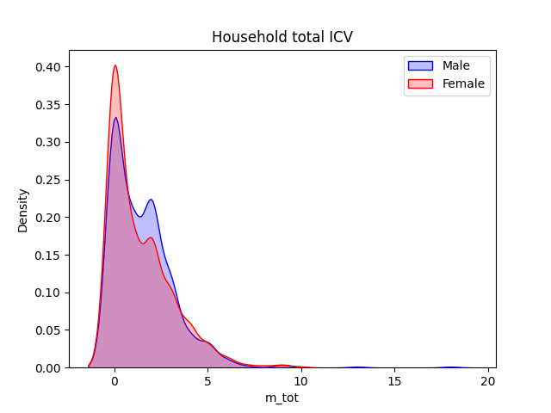
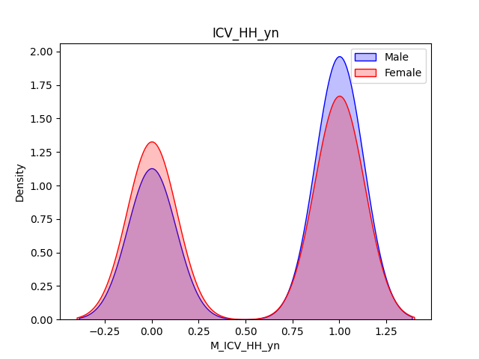

Slide 23
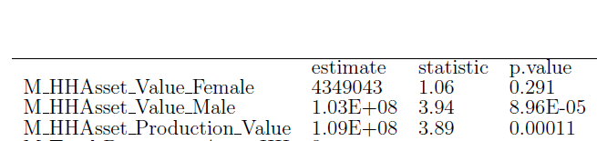

Slide 24
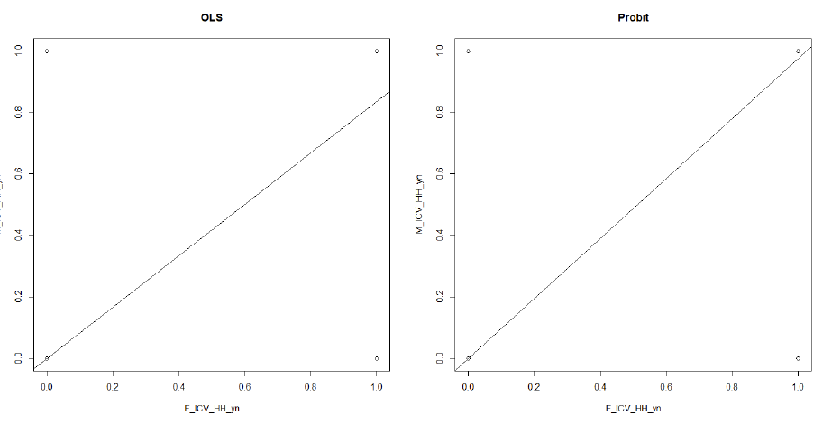

Slide 25
A measurement error is called classical if it is independent of the latent true values; otherwise, it is called nonclassical. There have been many studies on identification and estimation of linear, nonlinear, and even nonparametric models with classical measurement errors, see, e.g. (Cheng and Van Ness 1999; Carroll, Ruppert, Stefanski, and Crainiceanu 2006) for detailed reviews.
However, numerous validation studies in survey data sets indicate that the errors in self-reported variables, such as earnings, are typically correlated with the true values, and hence, are nonclassical (Bound, Brown, and Mathiowetz 2001).
Nguimkeu et al. (2019): ”Much less is known about the case in which the regressor and the measurement error are both endogenous.”

Slide 27
Introduction & Motivation
The importance of incorporating a gender perspective in social and economic sectors
e.g., Quisumbing et al. (2014); Fortmann (2009)) highlighted that neglecting to acknowledge the varying roles, disparities, and inequalities between men and women in the agricultural sector poses a significant risk to the success of agricultural development efforts
Adoption = f(assets, gender, education, etc.)
Recent studies showed that self-reported data is possibly misclassified (Wossen et al., 2019).
Survey data on participation in social programs is subject to significant misreporting, with levels of misreporting that can reach as high as 50% (Meyer et al., 2009)
Wossen et al. (2019) indicated that the misreporting of adoption status is not exogenous to the
household’s characteristics.
Lynch et al. (2007) and Meyer et al. (2018) report that validation studies always find high rates of false negatives in the Supplemental Nutrition Assistance Program (SNAP) ranging from 20% to 50%, depending on the survey and period after reviewing 35 case studies,
Ragasa (2012) found that women have ”much slower observed rates of adoption of a wide range of technologies than men.
A measurement error is called classical if it is independent of the latent true values; otherwise, it is called nonclassical.

Slide 28
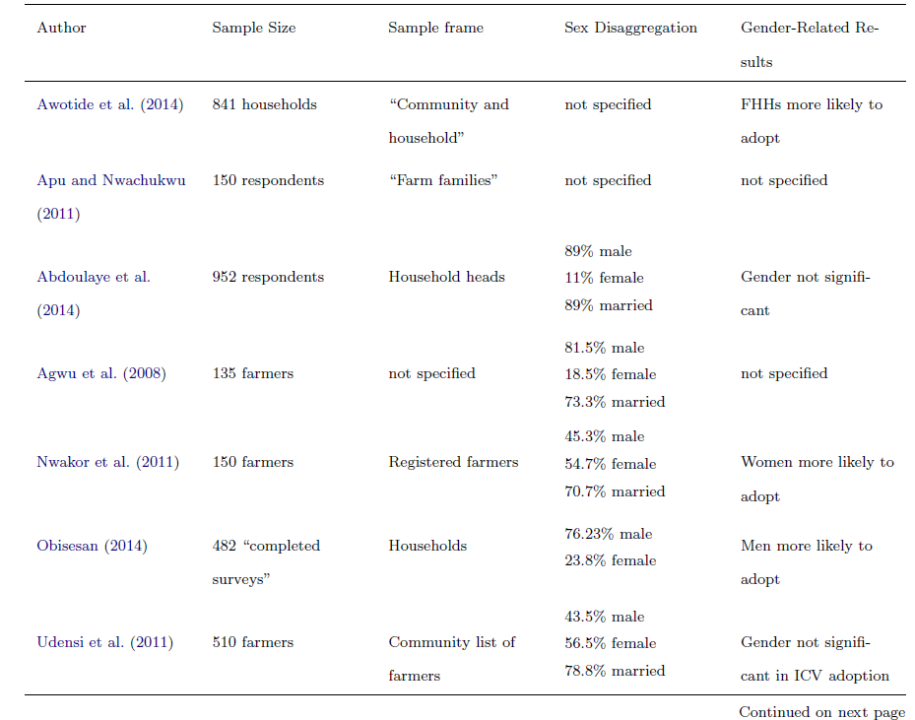

Slide 30
Correcting for measurement error
Auxiliary dataset
IV: Hu, Y. and Schennach, S.M., 2008. Instrumental variable treatment of nonclassical measurement error models. Econometrica, 76(1), pp.195-216.

